Slide 1

Note: The data and information in this document is reflective of a hypothetical situation and client. This document is to be used for KPMG Virtual Internship purposes only.
Sprocket Central Pty Ltd
Data analytics approach
Serigne Modou Diop Junior Consultant

Slide 2
Note: The data and information in this document is reflective of a hypothetical situation and client. This document is to be used for KPMG Virtual Internship purposes only.
Agenda
Introduction
Data Exploration
Model Development
Interpretation

Slide 3

Note: The data and information in this document is reflective of a hypothetical situation and client. This document is to be used for KPMG Virtual Internship purposes only.
Introduction
Project background : Sprocket Central Pty Ltd
Sprocket Central Pty Ltd, a company specialising in high-quality bicycles and cycling accessories.
Project objective: Target customers to generate value.
The three key data sets: Customer demographics, Customer addresses, Transaction data.
Presentation objective: To present the data analysis approach.

Slide 4
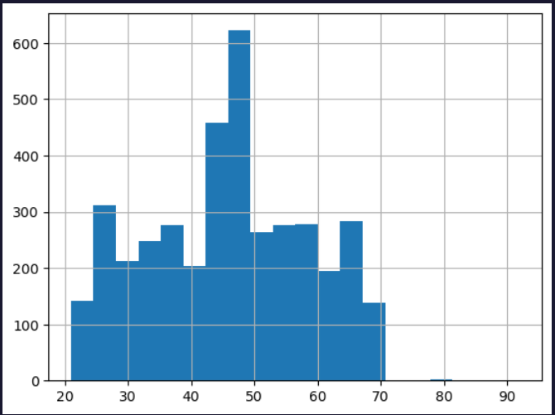
Note: The data and information in this document is reflective of a hypothetical situation and client. This document is to be used for KPMG Virtual Internship purposes only.
Data Exploration
Activities and visualisations
Data mining activities:
Analysis of data distributions.
Feature engineering.
Managing missing and outlier data.
Visualisations :
Examples of histograms, bar charts, etc.
Preliminary Insights:

Slide 5
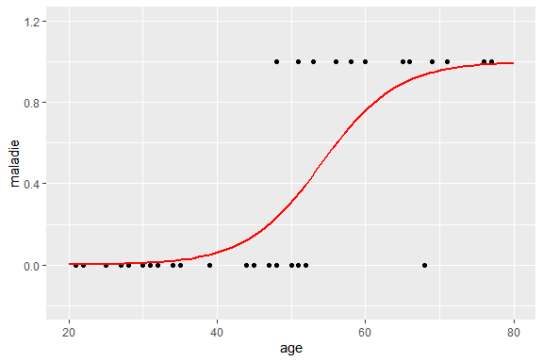
Note: The data and information in this document is reflective of a hypothetical situation and client. This document is to be used for KPMG Virtual Internship purposes only.
Model Development
Methods and variables
Model development methods :
Logistic regression (or other method).
Model variables.
Training and testing the model.
Explanation of the methodology.

Slide 6
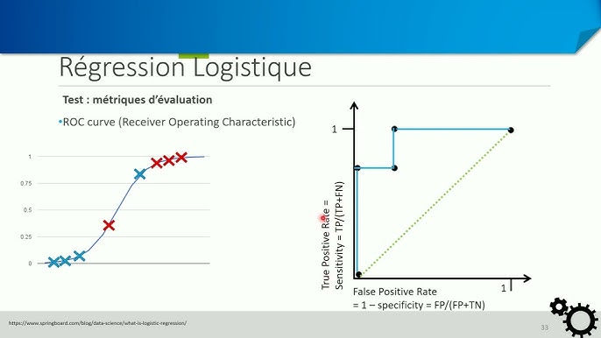
Note: The data and information in this document is reflective of a hypothetical situation and client. This document is to be used for KPMG Virtual Internship purposes only.
Interpretation
Metrics and recommendations
Interpretation of results: Evaluation metrics (precision, recall, etc.).
Recommendations based on model results.

Slide 7
Note: The data and information in this document is reflective of a hypothetical situation and client. This document is to be used for KPMG Virtual Internship purposes only.
Thanks

